Slide 1

Expenses of Polish municipalities budgets on education and upbringing in 2016
Ireneusz Korpusik
c00265954

Slide 3
I have selected 100 municipalities as a sample. I have add also small explanation about polish words which are saved in .csv file
wojewodztwo | voivodship | wydatki | expenses
gmina | municipality | wiejska | rural
dochody | revenue, income | miejsko-wiejska | urban-rural
miejska | urban

Slide 4
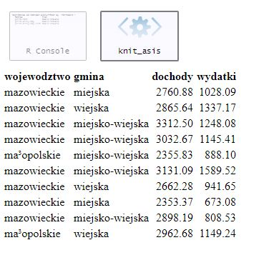
First of all I read the csv data and displayed first 10 rows

Slide 5
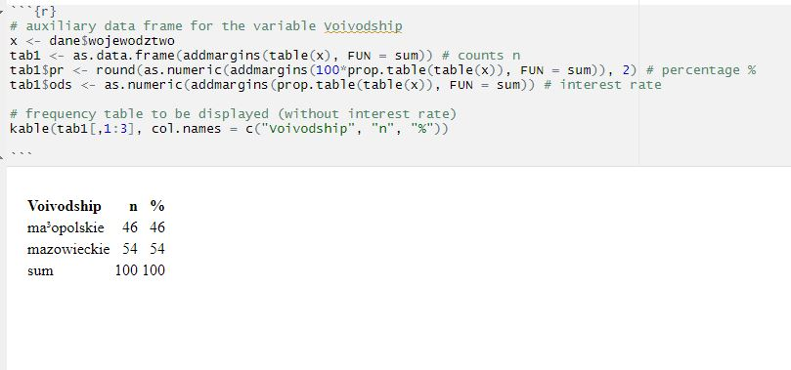
I’ve started doing structure analysis

Slide 6
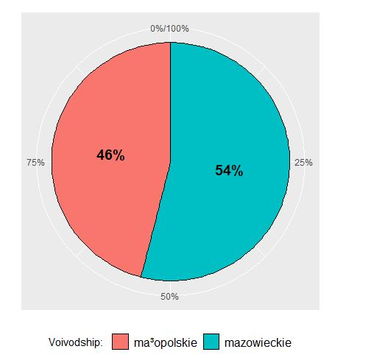
In the surveyed group there were slightly more municipality from Mazowieckie voivodship

Slide 7
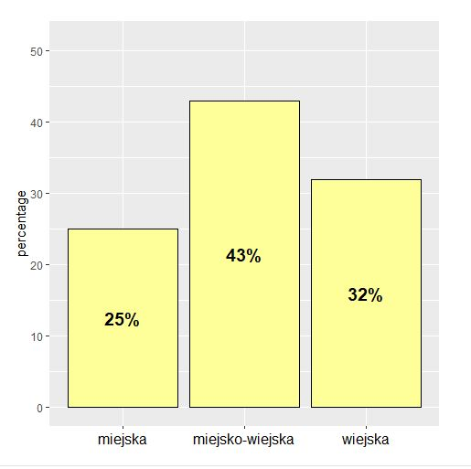
I’ve also checked type of municipality which is presented as a bar-chart (urban, rural and urban-rural)

Slide 8
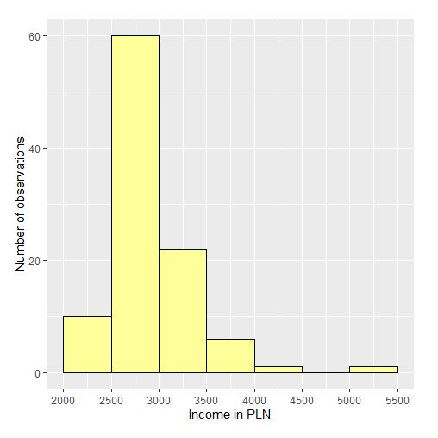
The lowest observed amount of income per capita was PLN 2328.38

Slide 9
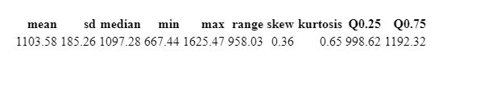
Budget expenses for education

Slide 10
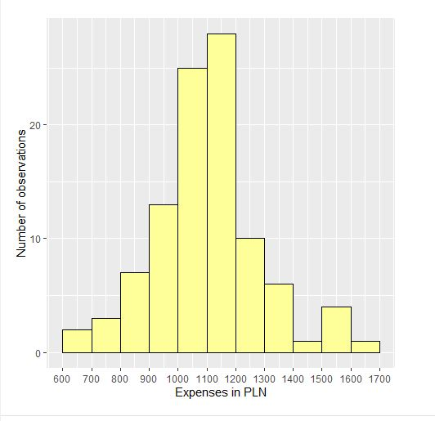
The average amount of budget expenses per capita

Slide 11
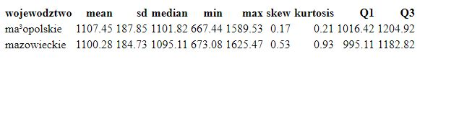
Comparison of distributions which was held on education depending on the selected province and the type of municipality

Slide 12
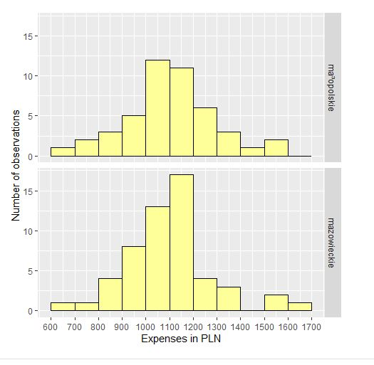
Values of all measures are similar in both provinces, the biggest differences concern only asymmetry. The higher values were found in Mazowieckie province

Slide 13
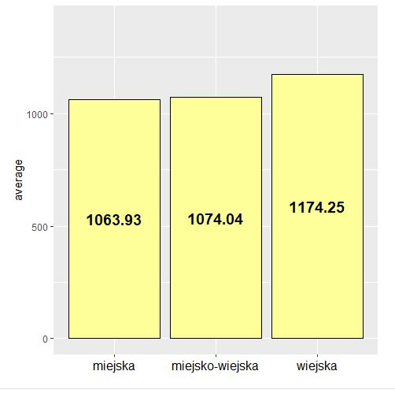
Rural municipalities are significantly different from urban and urban-rural municipalities. There is no big difference between urban and urban-rural municipalities

Slide 14
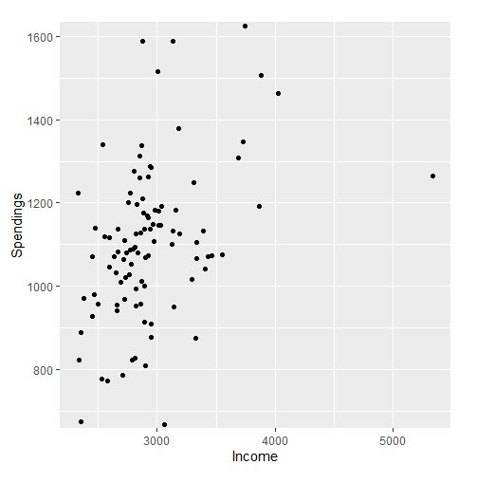
In the last part of analysis I examined relationalship between amount of income and amount of spending

